Slide 1
Data Visualization with Tableau
Lecture 1

Slide 2
A bit of history

Slide 3
Two types of visual communication
Main role is to convince/persuade the audience of something.
Example: this one.
Presentation
Main role is to answer questions. The presenter should be optional!
Example: a map.
Visualization

Slide 4
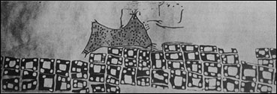
Catal Hyuk, Turkey
6200 BC

Slide 5
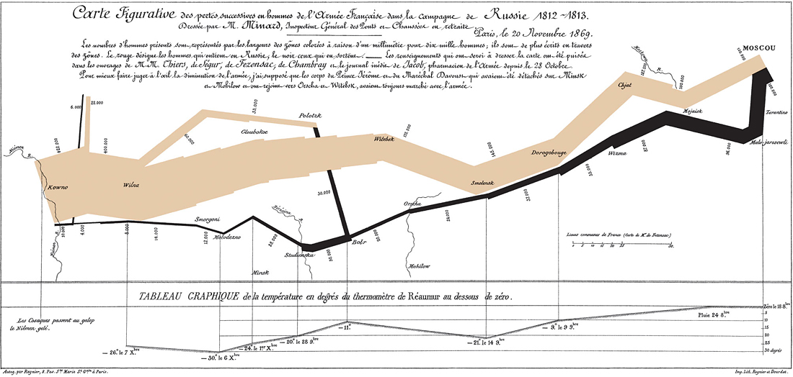
The Russian Campaign, 1812-1813

Slide 6
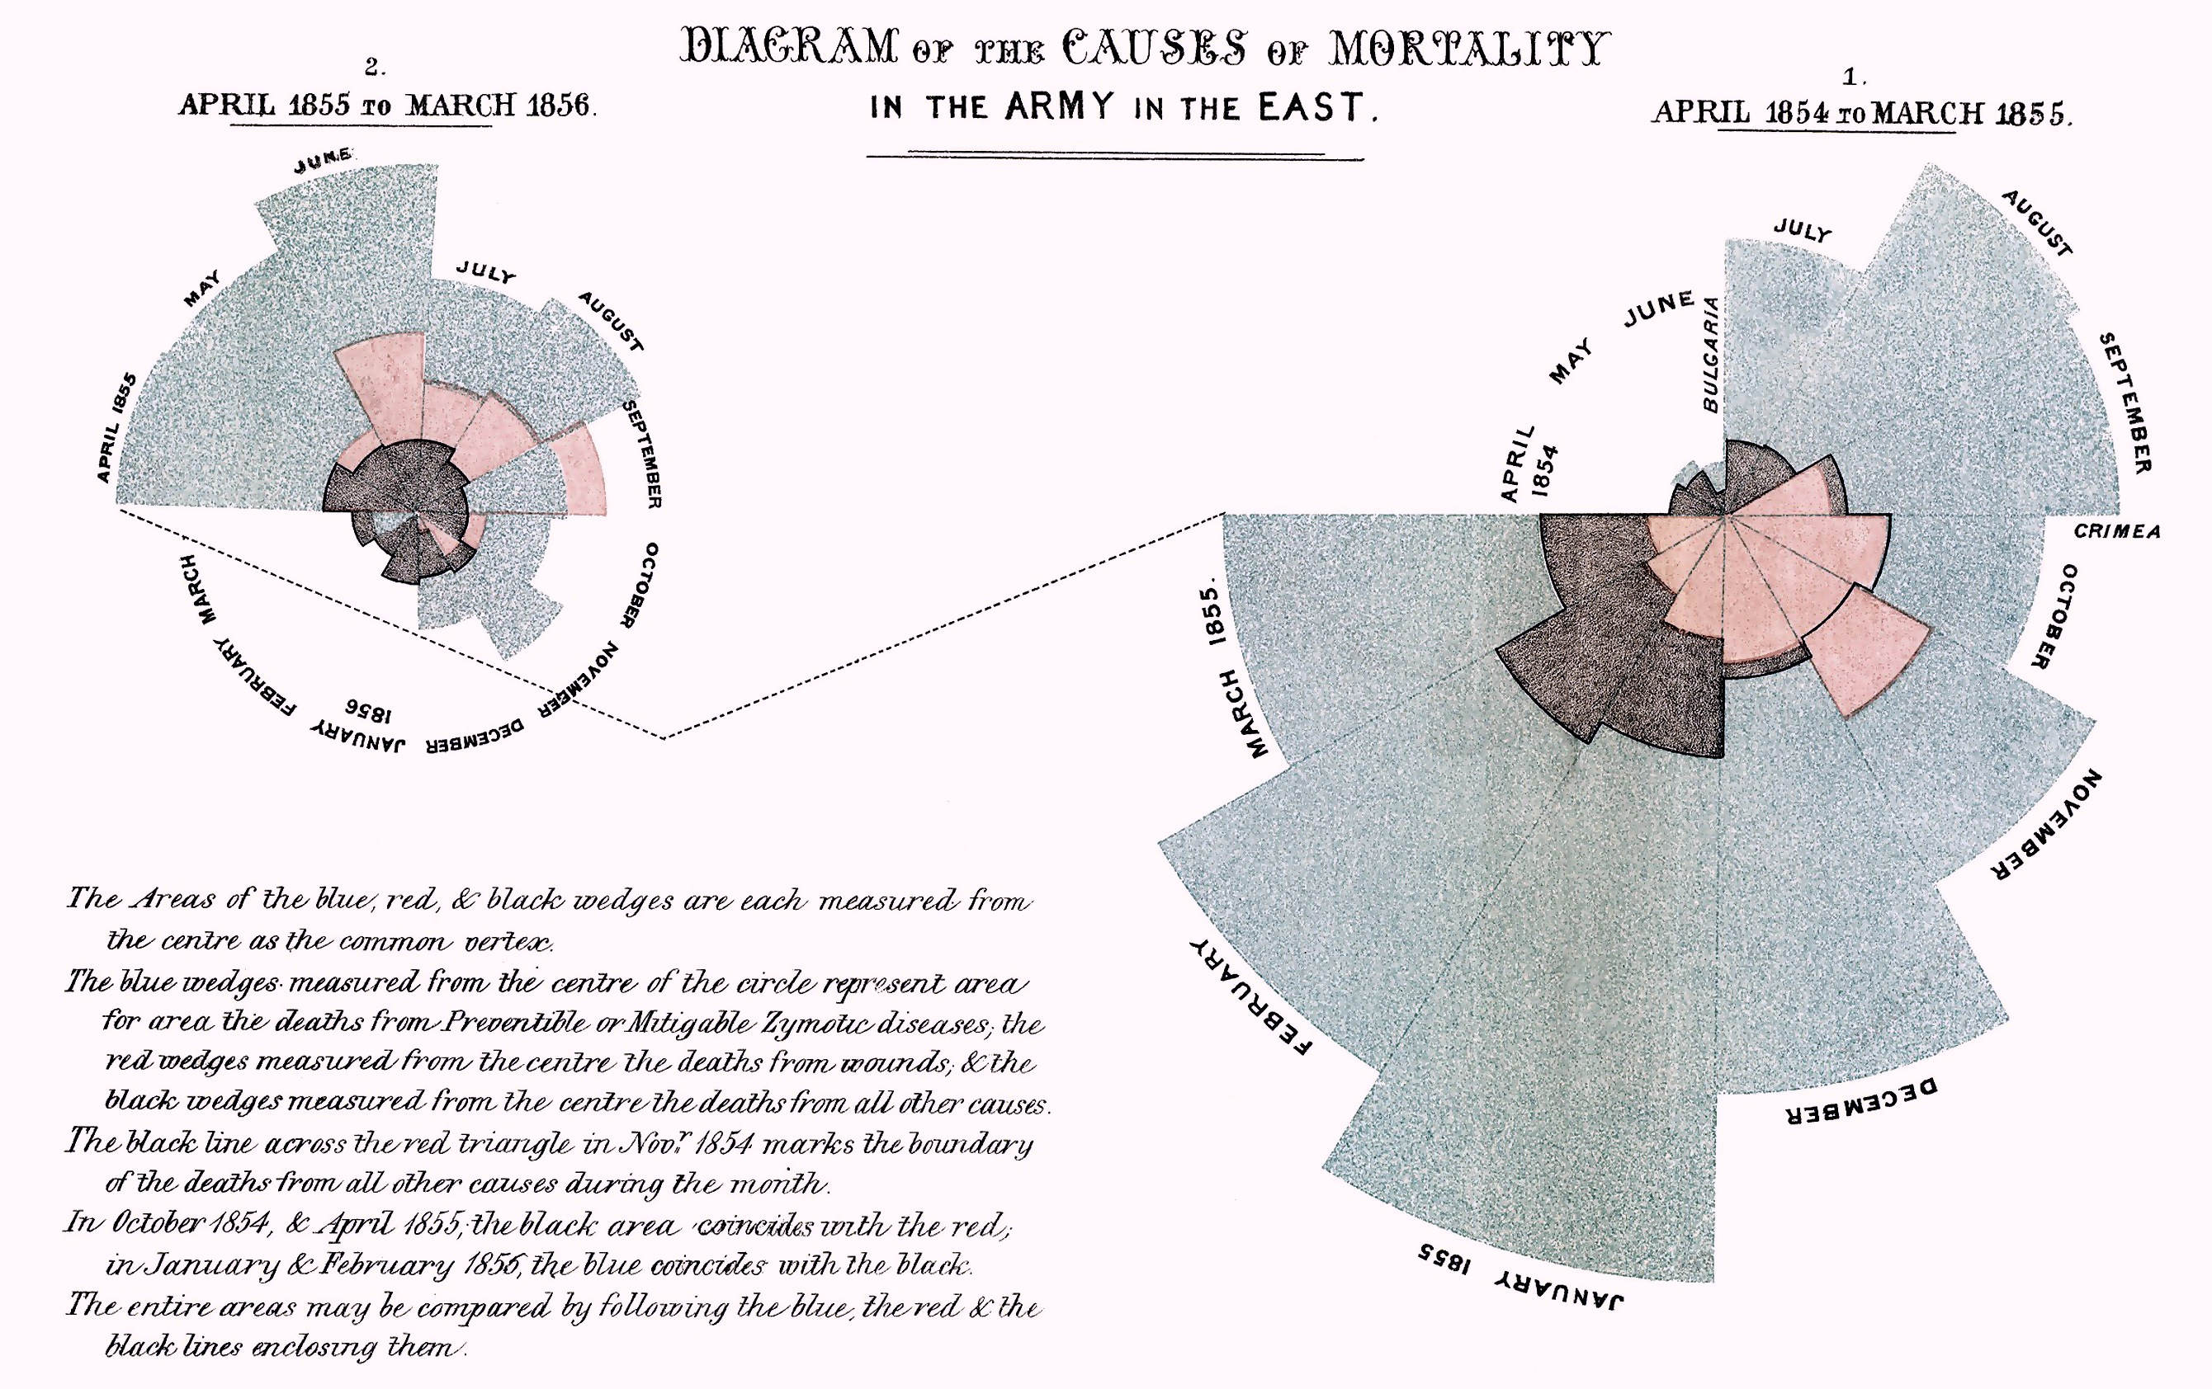
Florence Nightingale’s chart, 1854

Slide 7
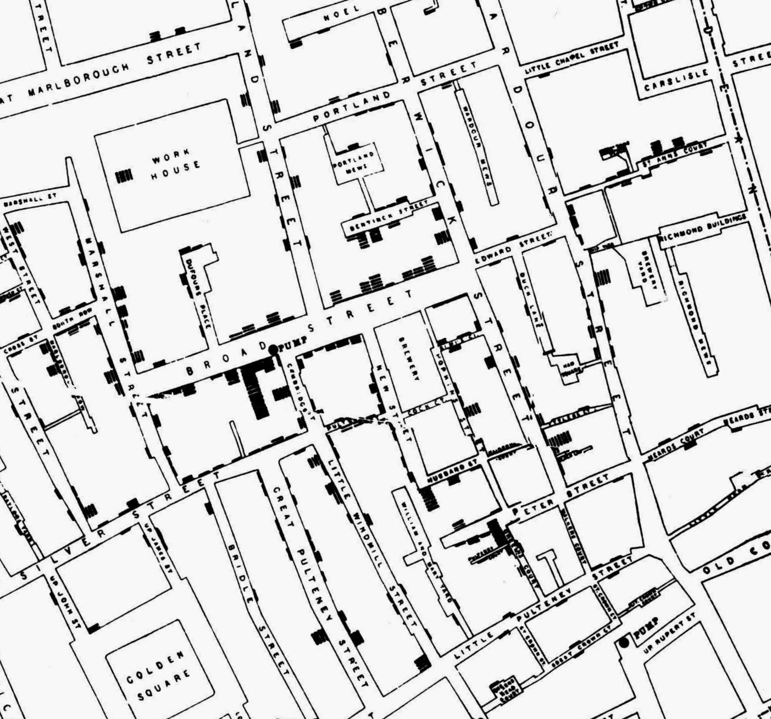
Cholera Epidemic Outbreak, 1885

Slide 8
Visual Analysis

Slide 9
The data visualization cycle
Acquire
Filter
Enhance
Tune
Deliver

Slide 10
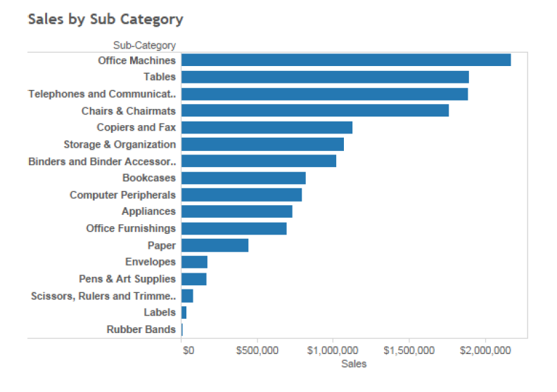
Exploring data visually…

Slide 11
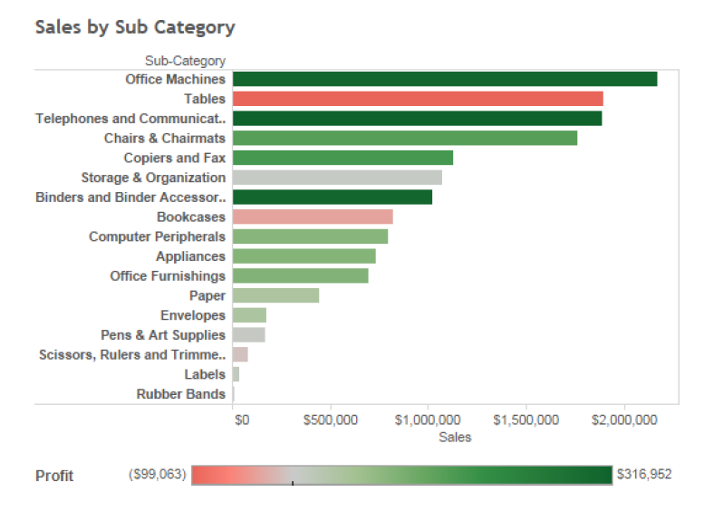
…using visual tools to dive deep

Slide 12
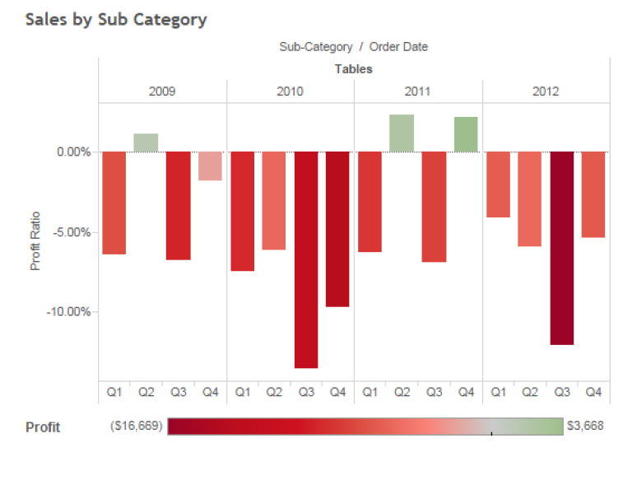
So “Tables” are bad for a really long time!

Slide 13
Visual Perception

Slide 14
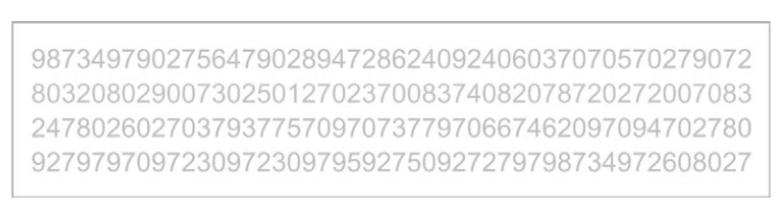
How many 5’s are there?

Slide 15
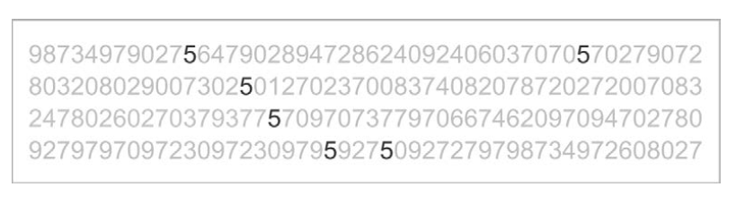
And now?

Slide 16
Attentive Processing: The brain needs to focus hard.
Pre-Attentive Processing: The answer is just obvious.

Slide 17
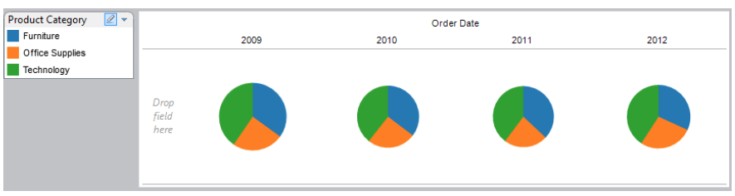
Which products are trending up?

Slide 18
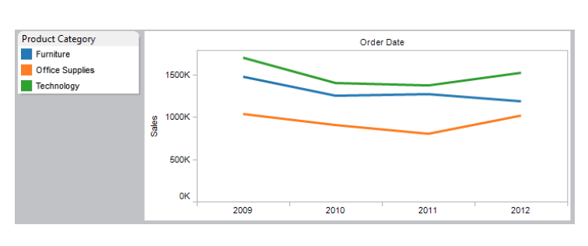
Which products are trending up?

Slide 19
Gallery of examples

Slide 20
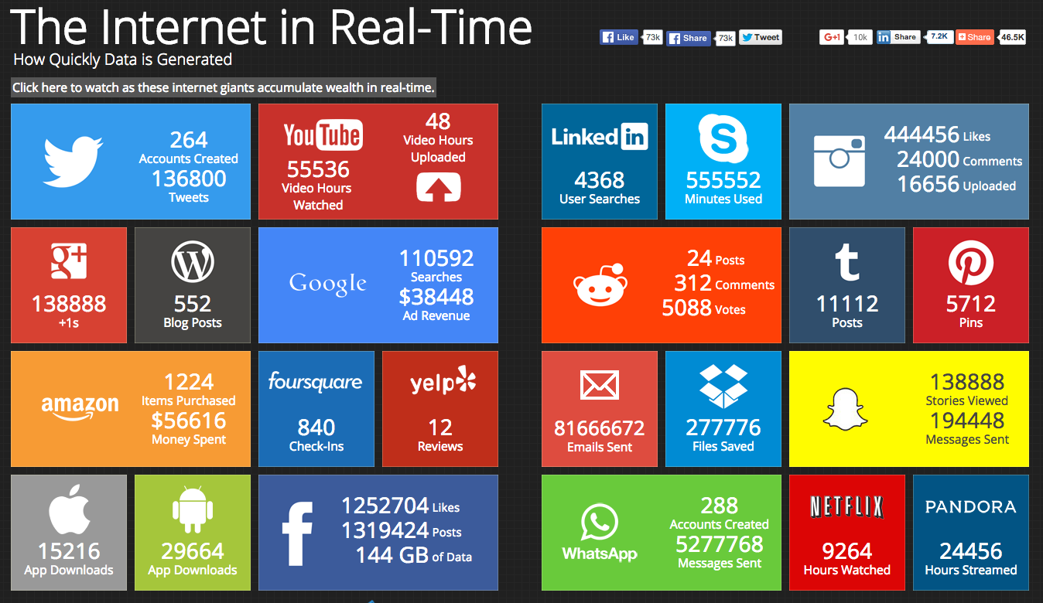

Slide 21
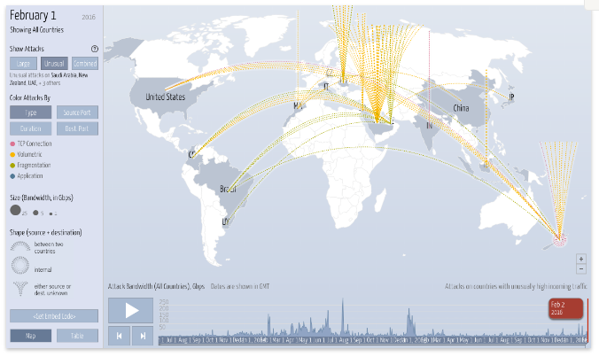

Slide 22
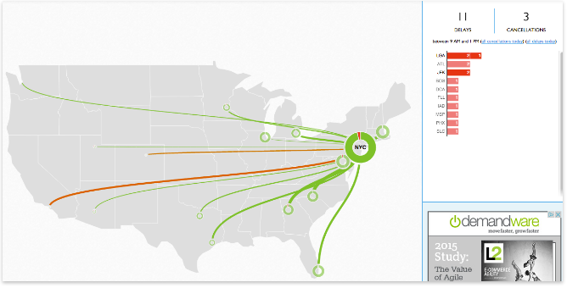

Slide 23
Gallery of counterexamples

Slide 24
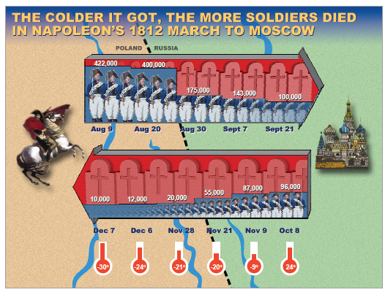

Slide 25
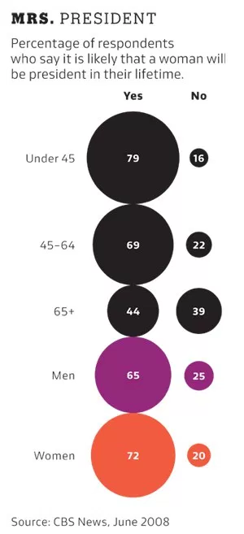

Slide 26
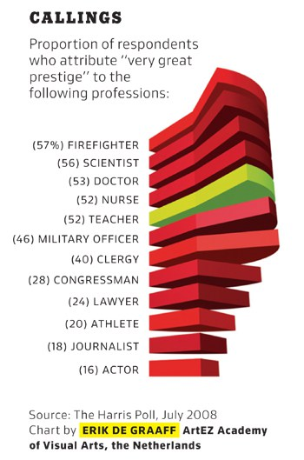
Many more in:
http://viz.wtf/

Slide 27
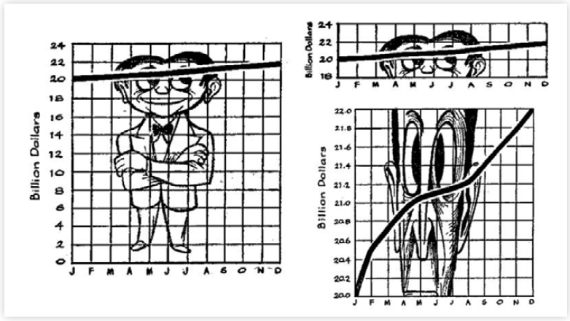

Slide 28
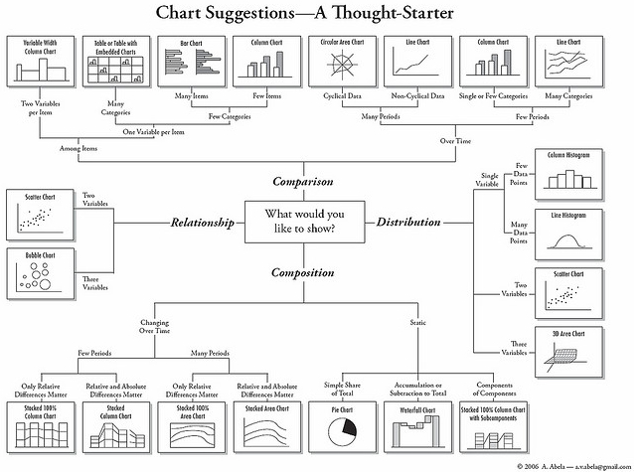

Slide 29
Resources
http://www.makeovermonday.co.uk/
http://flowingdata.com/2017/01/24/one-dataset-visualized-25-ways/
https://public.tableau.com/en-us/s/gallery
David McCandless
https://youtu.be/5Zg-C8AAIGg
Hans Rosling
https://www.ted.com/talks/hans_rosling_shows_the_best_stats_you_ve_ever_seen#

